Slide 1
Make Your Own PPE!
or the “PPE Paper Doll”

Slide 2
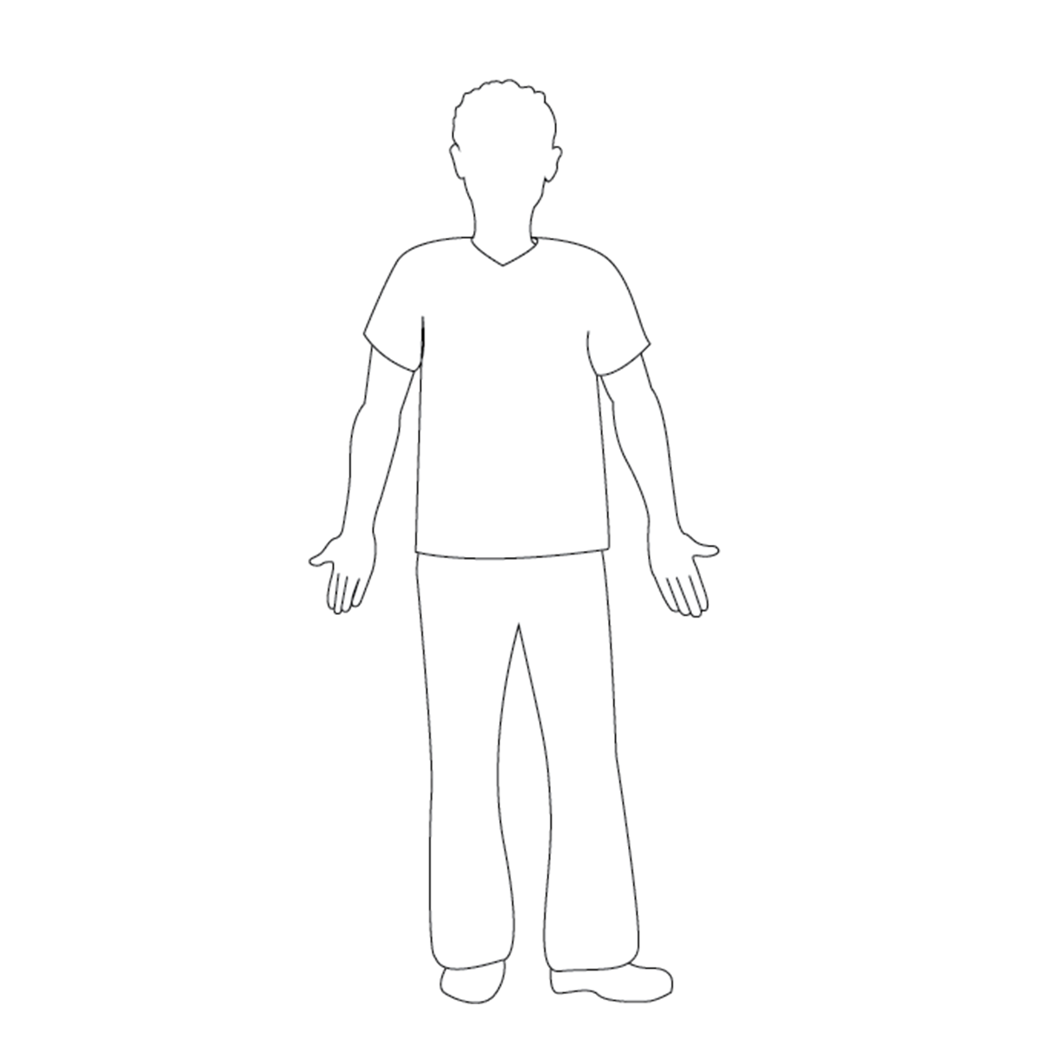
Use this as a base.
Copy paste PPE onto this slide. Do NOT scale or crop them!

Slide 3
First, pick Body PPE
Copy paste the image of the desired PPE to slide1. Do NOT scale or crop image.

Slide 4
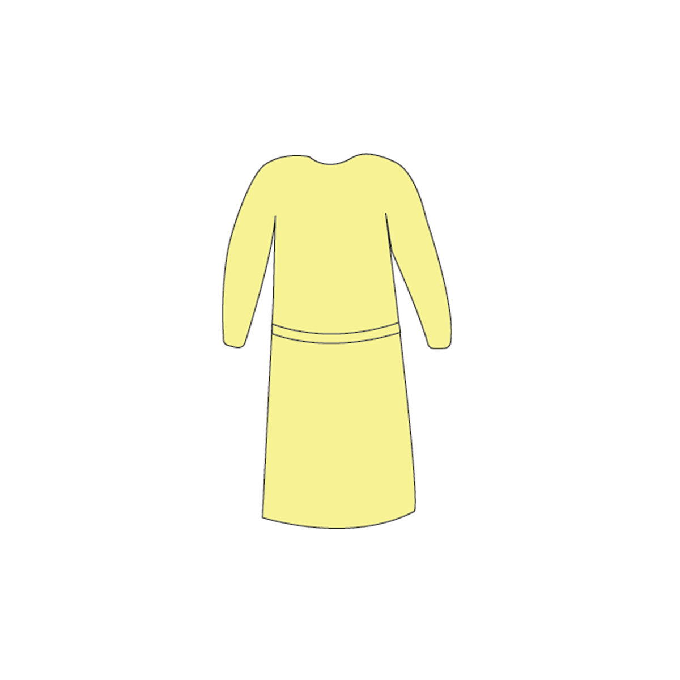
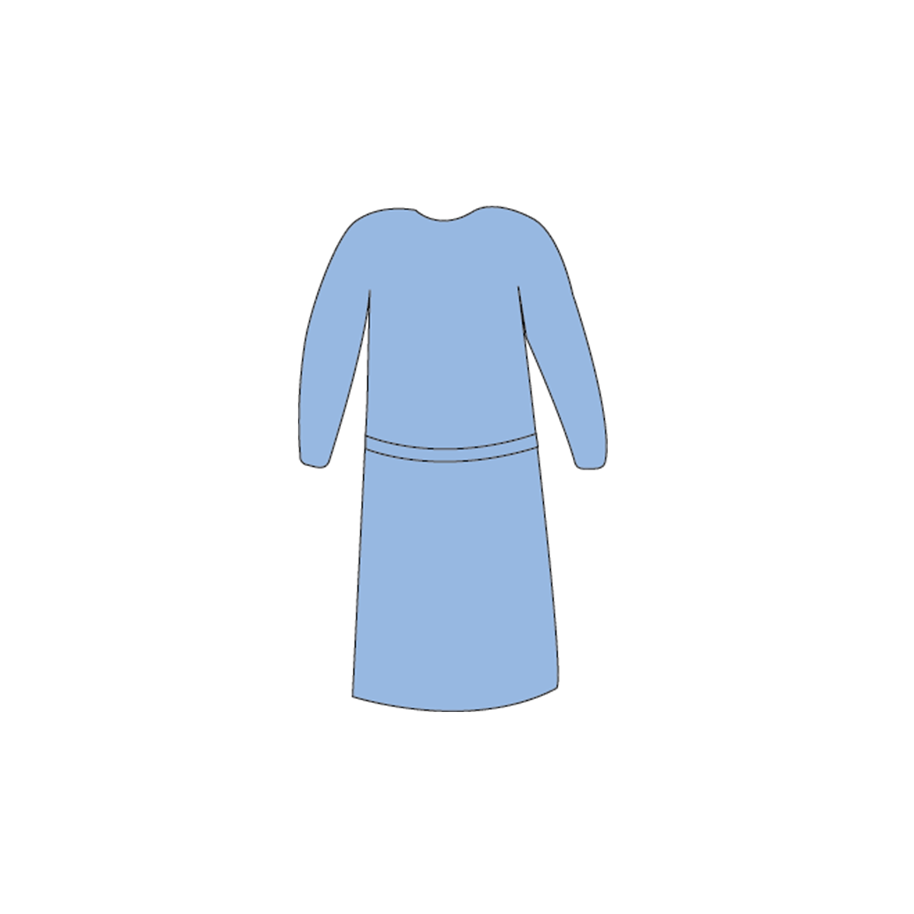
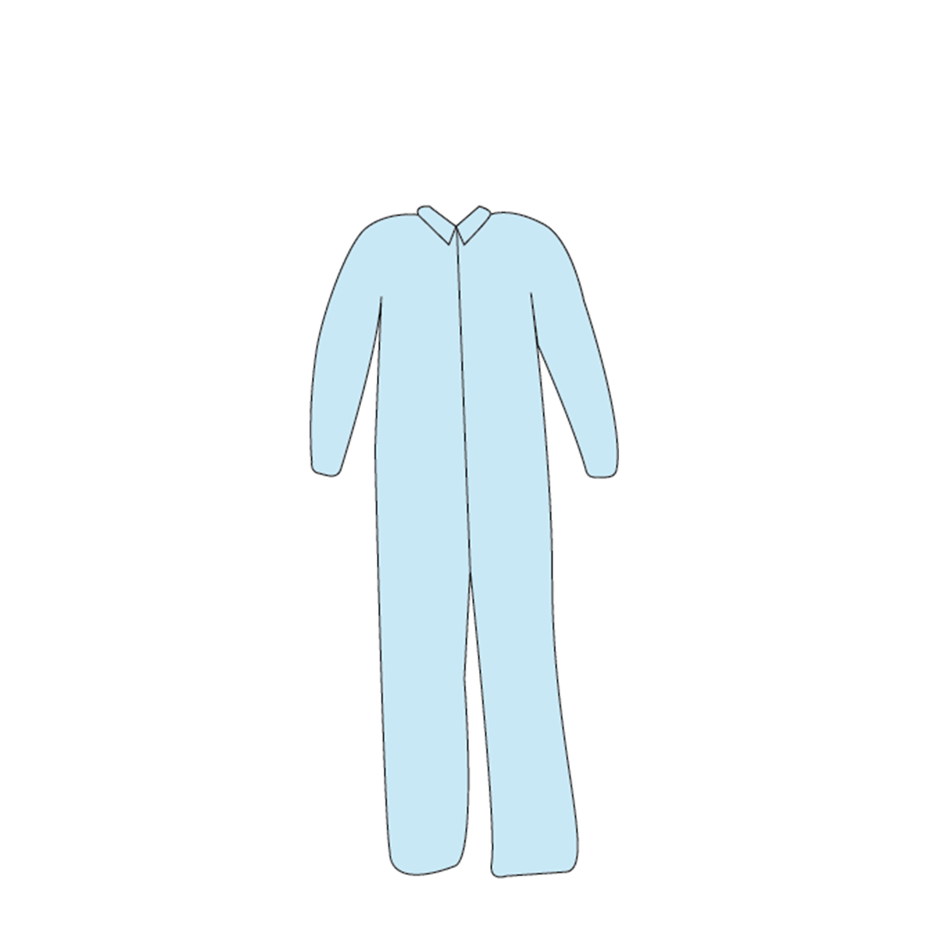
Contact Gown
Reusable Gown
Coveralls

Slide 5
2. Second, pick gloves
Copy paste the image of the desired PPE to slide1. Do NOT scale or crop image.

Slide 6
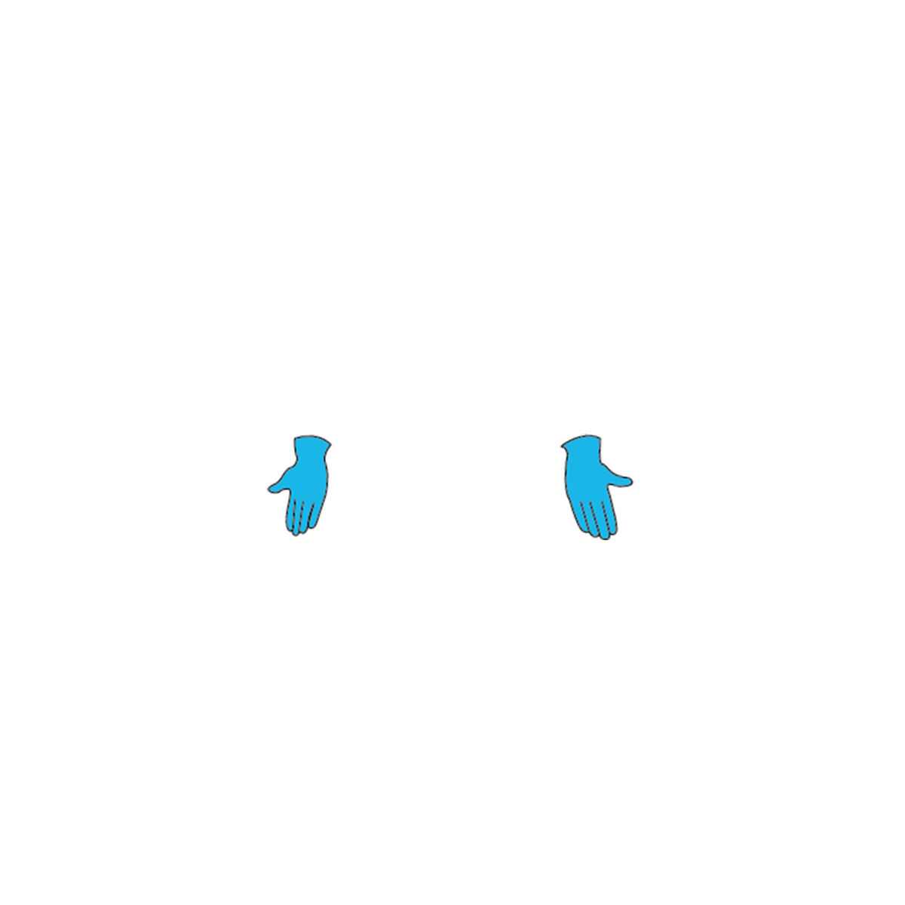
Extended cuff gloves
Regular gloves

Slide 7
3. Let’s move onto masks
Copy paste the image of the desired PPE to slide1. Do NOT scale or crop image.

Slide 8
Procedure mask
N95

Slide 9
3. Almost there! Moving onto head PPE
Copy paste the image(s) of the desired PPE to slide1. Do NOT scale or crop image.

Slide 10
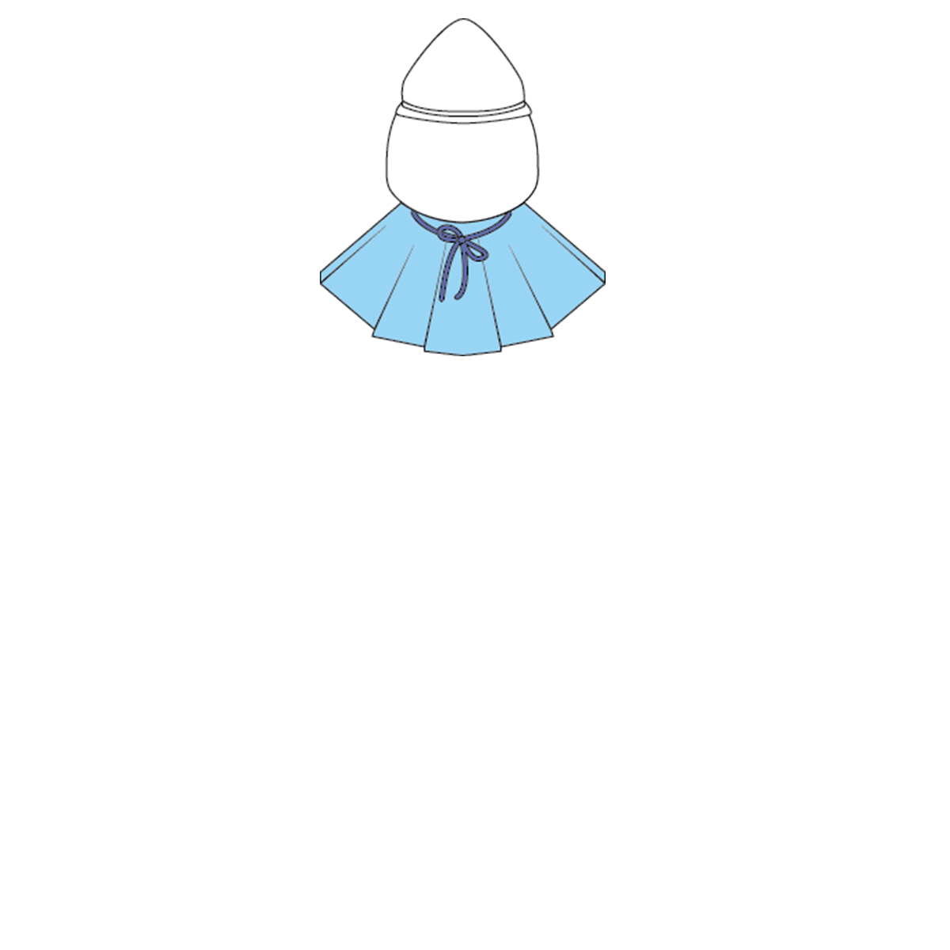
CAPR
PAPR

Slide 11
Goggles
Face shield

Slide 12
If you have something like this, you’re on the right track!
Let’s align all of them now.

Slide 13
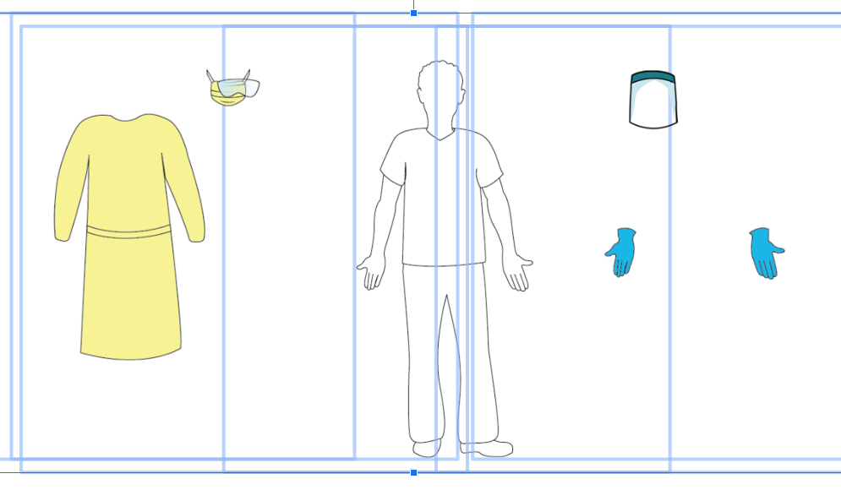
Select everything...

Slide 14
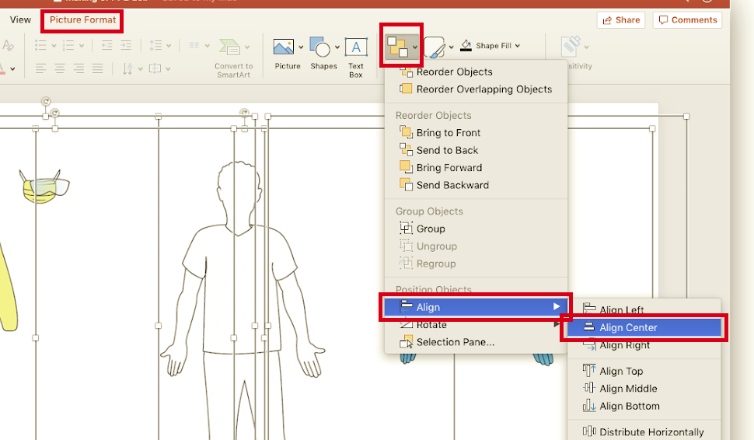
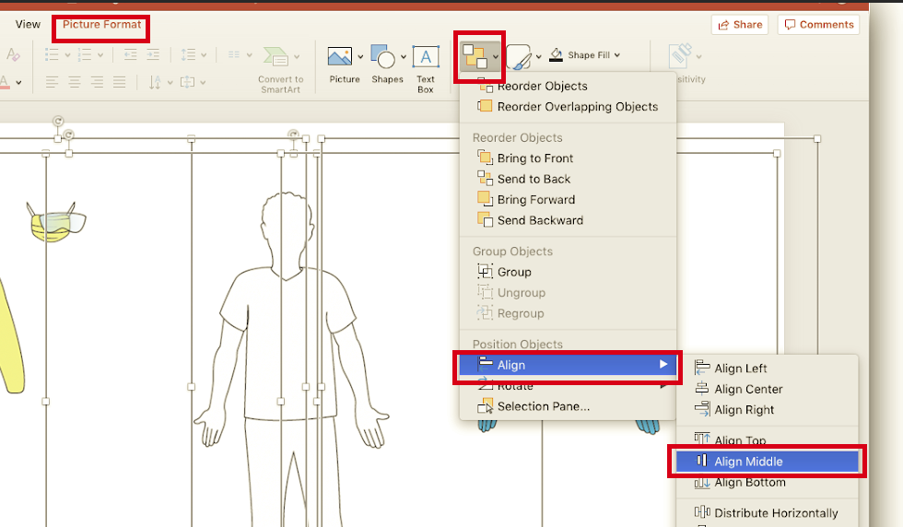
On Powerpoint:
Go to Picture Format > Arrange > Align > Align Center and then Arrange > Align > Align Middle
Arrange icon looks like this:

Slide 15
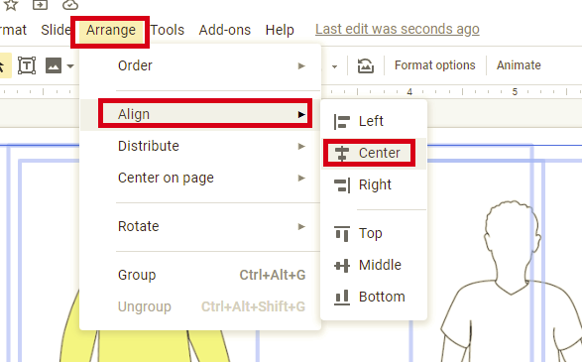
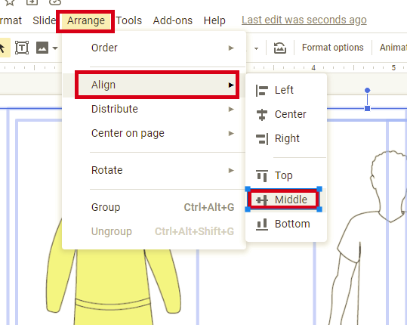
On Google Slides:
Go to Arrange > Align > Center and then Arrange > Align > Middle

Slide 16
Voila!

Slide 17
Troubleshooting
The order is wrong - You HAVE to follow the order of the instructions or otherwise the order will get messed up. If you do mess up, you can use Arrange > send backward or send forward to correct the order.
They don’t align - If you change the size or crop the image, it won’t align. Reset or download the file again.
I want to scale it - Finish all the steps and THEN select everything to scale. You can also group them all.
I want to make multiple options - Make as many copies of the first slide as you want, before making any modifications.

